Slide 1

TRAPTRACE – AI-POWERED SCAM DETECTOR AND PHISHING MESSAGE DETECTOR
SOA PROJECT REVIEW –2
 | UNDER THE GUIDANCE OF Dr. Neelima Gogineni Department of Computer Science and Engineering KLH CSE Bowrampet Campus
TEAM MEMBERS 1. K.Srikar- 2420090111 2. G.Vineet – 2420030375 3. M.Rohith – 2420030783

Slide 2
PROBLEM STATEMENT
WHY TRAPTRACE?
Scam and phishing messages increasingly use deceptive language, urgency, impersonation and malicious links.
Traditional blacklist and rule-based approaches may miss newly generated or obfuscated threats.
Users often cannot determine whether a suspicious message or URL is safe before interacting with it.
Many solutions focus on a single threat vector instead of combining message and URL analysis.
A practical system is needed to provide fast, understandable and AI-assisted threat assessment.
Proposed direction: combine NLP + ML/DL + URL feature analysis in one web platform.

Slide 3
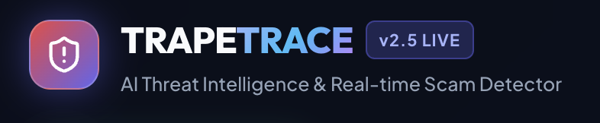
Web Page Symbol

Slide 4
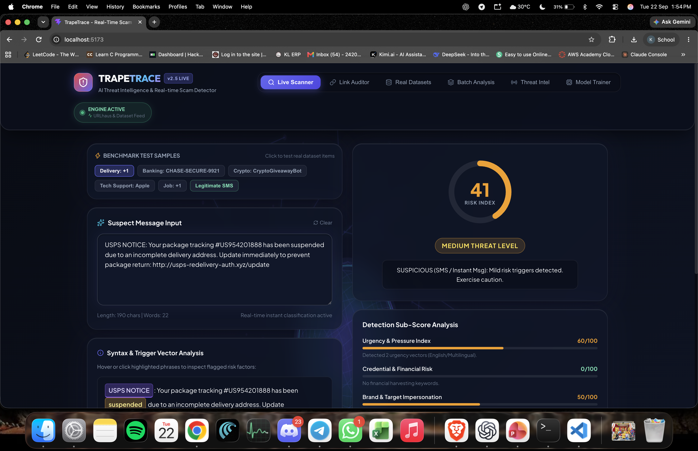
TrapeTrase Excition – Live Scanner

Slide 5
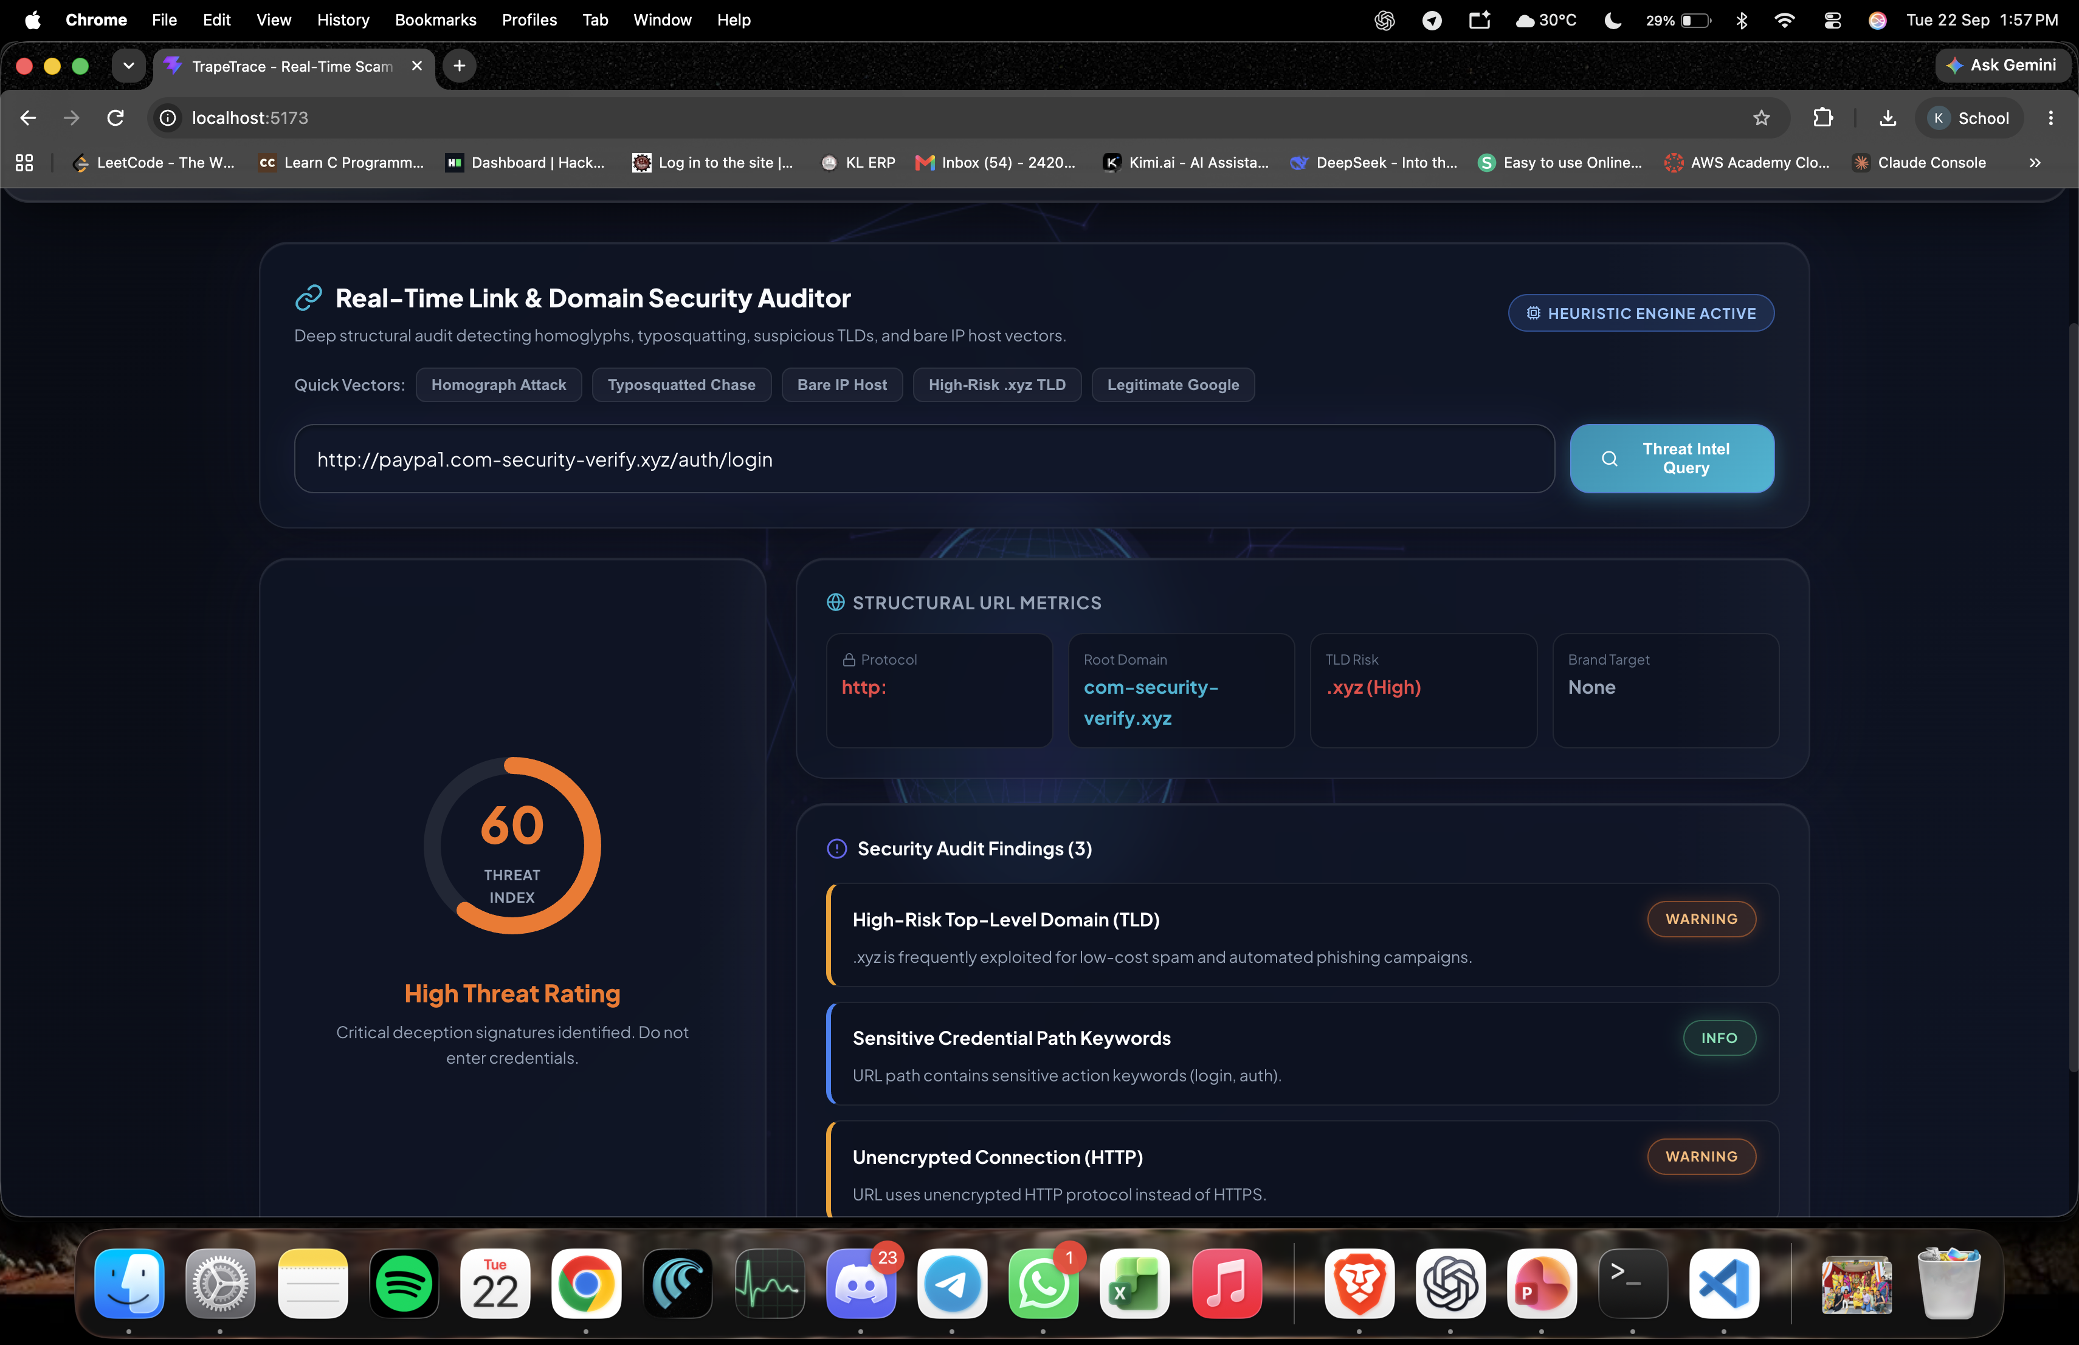
TrapeTrace – Link Auditor

Slide 6
METHODLOGY
Data Collection: Collect scam-related data from URLs, messages, emails, and online sources.
Data Preprocessing: Clean and normalize the collected data to remove unnecessary or duplicate information.
Feature Extraction: Identify suspicious patterns such as fake links, misleading keywords, and unusual domains.
Scam Detection: Apply rule-based techniques and machine-learning models to analyze the extracted features.
Risk Analysis: Assign a risk score based on the number and severity of detected scam indicators.
URL Verification: Check domain details, SSL status, redirects, and other website security characteristics.
Message Analysis: Scan user-provided messages for phishing, fraud, and social-engineering patterns.
Result Generation: Display whether the content is Safe, Suspicious, or Scam with supporting reasons.
User Interface: Provide an interactive website where users can easily submit URLs or text for analysis.
Testing & Deployment: Test the system with different scam cases and deploy the verified application for public use.

Slide 7
OBJECTIVES
Develop an AI-based system to classify scam and phishing messages.
Apply NLP preprocessing and feature extraction using NLTK and spaCy.
Use Scikit-learn, PyTorch and Hugging Face Transformers for intelligent classification.
Analyze suspicious URLs using lexical and structural characteristics.
Generate a clear threat category and risk assessment for the user.
Provide secure user authentication using JWT and store detection history in MySQL.
Build a responsive React.js frontend connected to FastAPI REST APIs.
Support testing, containerization and cloud deployment using Postman, Docker and AWS.

Slide 8
PROBLEM GAP IDENTIFICATION
SINGLE-VECTOR DETECTION
Many approaches emphasize only URLs, websites, or email text.
EVOLVING ATTACKS
Blacklists and static rules can struggle with new or obfuscated threats.
CONTEXT UNDERSTANDING
Keyword-only methods may miss the intent and context of deceptive messages.
EXPLAINABILITY
Users need understandable reasons for why content is classified as risky.
PRACTICAL INTEGRATION
A unified system is needed for AI detection, authentication, history and APIs.
TrapTrace addresses the gap by integrating message + URL analysis with modern NLP/AI models in a single platform.

Slide 9
INNOVATION, CREATIVITY, AND NOVELTY
INNOVATION
CREATIVITY
NOVELTY
AI-powered scam and phishing message classification.
Combines NLP, ML and deep-learning approaches.
Risk-oriented output for suspicious content.
Simple interface for submitting messages or URLs.
Highlights suspicious patterns and indicators.
Detection history helps users review previous analyses.
Unified message + phishing URL detection.
Transformer-based language analysis can capture context.
Designed as a deployable full-stack cybersecurity application.

Slide 10
FEASIBILITY AND PROJECT PLAN
FEASIBILITY
PROJECT TIMELINE
Technical: Python, FastAPI, React.js and AI/ML stack are practical for a student prototype.
Data: public phishing/scam datasets can support training and evaluation.
Operational: web interface provides a simple workflow for end users.
Deployment: Docker and AWS support reproducible deployment.
1. Research & Dataset
Weeks 1–2
2. Data Preprocessing
Weeks 3–4
3. ML/DL Model Development
Weeks 5–7
4. FastAPI + Database
Weeks 8–9
5. React Frontend & Integration
Weeks 10–11
6. Testing & Evaluation
Week 12
7. Docker + AWS Deployment
Week 13
8. Documentation & Final Demo
Week 14
Future Work: real-time threat intelligence • multilingual detection • browser/email integration • continual learning • explainable AI

